Slide 1


IOMP PROJECT IOT BASED AIR POLLUTION MONITOR
Sreyas Institute of Engineering and Technology
An Autonomous Institution
Approved by AICTE, Affiliated to JNTUH
Accredited by NAAC-A Grade, NBA (CSE, ECE & ME) & ISO 9001:2015 Certified
DEPARTMENT OF ELECTRONICS & COMMUNICATION ENGINEERING
Presented by (B-14)
MAHI SRIJA(22VE1A0492)
A.ALEKHYA(22VE1A0470)
S.GANESH(22VE1A04B8)

Slide 2
ABSTRACT
In recent years, growing concerns over environmental pollution and indoor air quality have highlighted the urgent need for efficient, low-cost, and real-time monitoring solutions. This project presents the design and implementation of a cloud-integrated air quality monitoring system using the ESP32 microcontroller. The system uses multiple gas sensors—MQ2, MQ6, and MQ135—in conjunction with a DHT11 sensor for measuring ambient temperature and humidity. The ESP32’s built-in Wi-Fi capability enables seamless transmission of sensor data to a Firebase Realtime Database, providing cloud-based storage. A 16x2 I2C LCD module displays current readings locally, while a buzzer alerts users when gas concentrations exceed safety thresholds. This work contributes to the growing field of Internet of Things (IoT)-based environmental sensing by offering a scalable and cost-effective solution for real-time air quality surveillance and alerting.
KEYWORDS : ESP32, Air Quality Monitoring, IoT, MQ2, MQ6, MQ135, DHT11, Firebase Realtime Database, Real-Time Monitoring, Buzzer Alert System, LCD Display.

Slide 3
COMPONENTS
ESP32 Development Board
→ Main microcontroller with Wi-Fi capability.
2.MQ2 Gas Sensor
→ Detects LPG, smoke, alcohol gases.
→ Analog output to GPIO 34.
3.MQ6 Gas Sensor
→ Detects LPG, butane, propane.
→ Analog output to GPIO 35.
4.MQ135 Gas Sensor
→ Detects CO2 and other harmful gases.
→ Analog output to GPIO 32.
5.DHT11 Temperature and Humidity Sensor
→ Measures ambient temperature and relative humidity.
→ Digital signal pin to GPIO 4.
6.Buzzer (Active)
→ Sound alert when gas levels exceed thresholds.
→ Connected to GPIO 12.

Slide 4
7. I2C LCD Display (16x2, I2C Interface )
→ Displays sensor values and alerts.
→ Connected via I2C:
SDA → GPIO 21
SCL → GPIO 22
🔋 Power Components:
8. Mini Buck Converter(HW316):
→ Steps down 12V or 9V input to 5V or 3.3V
→ Powers ESP32 and sensors safely
9. Breadboard or PCB
→ For prototyping or soldered assembly.
10. Jumper Wires
→ For connecting components.
11. Power Source
→ 9V/12V adapter or battery for input to buck converter.

Slide 5
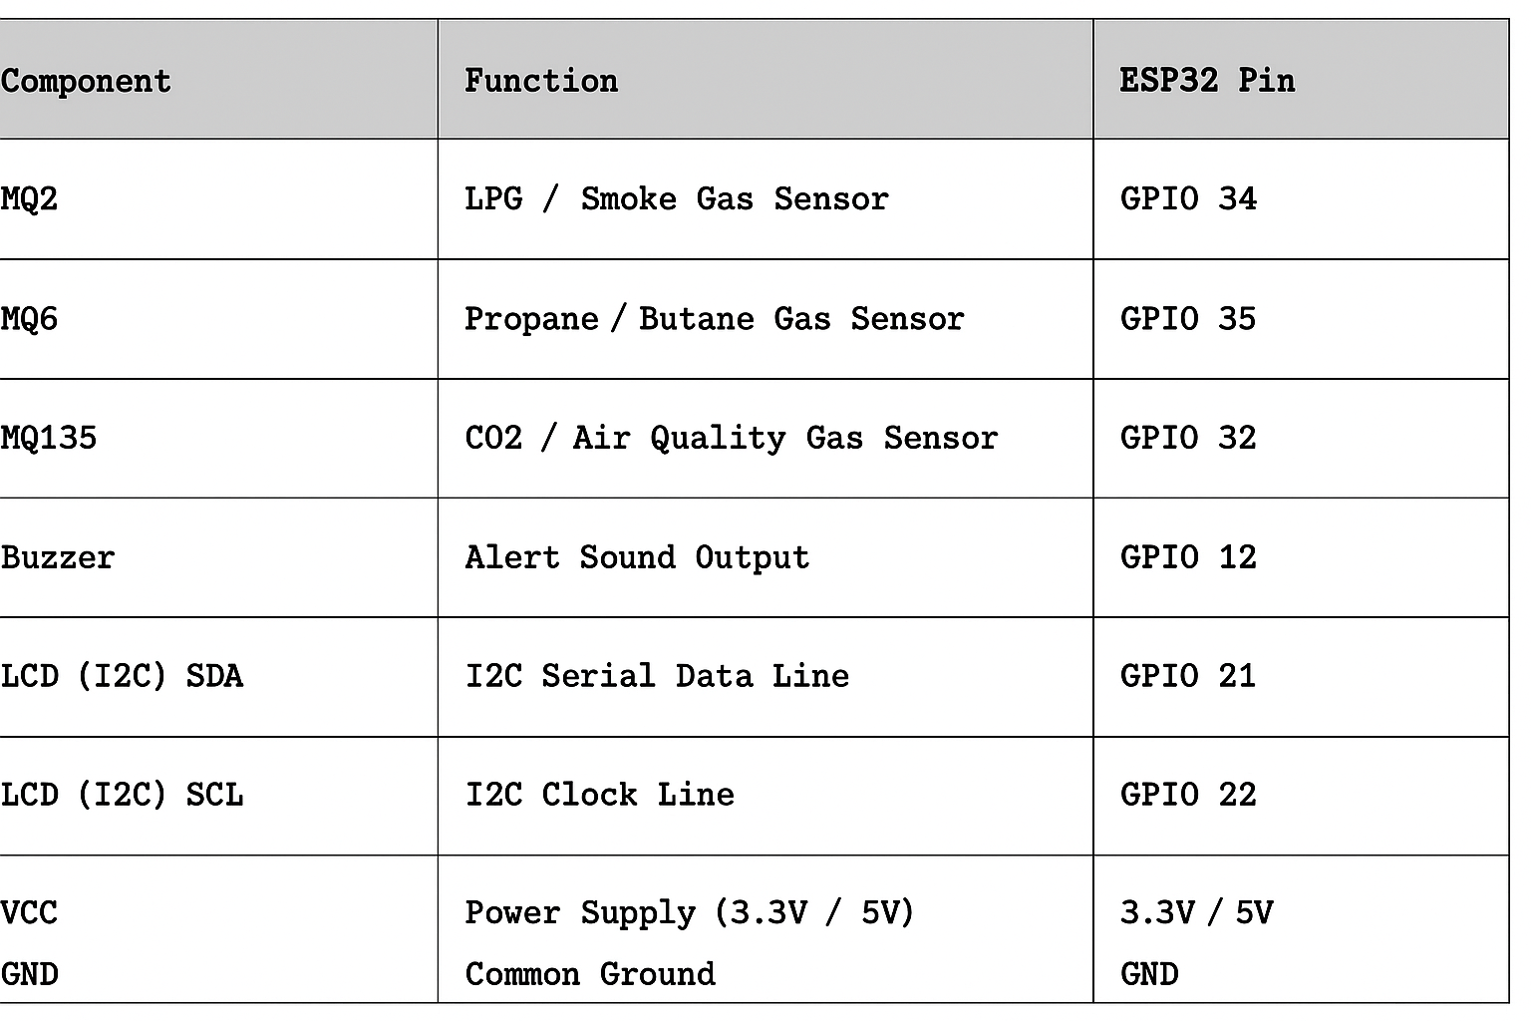
SENSOR AND MODULE CONNECTIONS

Slide 6
EXPLAINATION
This project presents the development of a real-time air quality monitoring system using an ESP32 microcontroller, integrated with multiple gas sensors (MQ2, MQ6, and MQ135), a DHT11 temperature and humidity sensor, and a buzzer for alert notifications. The system is designed to detect harmful gases such as LPG, smoke, methane, and carbon dioxide, as well as environmental parameters like temperature and humidity. The sensor data is processed and visualized locally on a 16x2 I2C LCD display and simultaneously uploaded to a cloud-based Firebase Realtime Database. Wi-Fi connectivity is established through the ESP32, enabling remote access to live data from anywhere via the internet. The system continuously monitors gas concentrations, and if any of the sensor readings exceed a predefined safety threshold, it triggers an alert by activating a buzzer and updating the alert status in the cloud. This approach ensures timely warnings for hazardous air quality conditions. The integration of cloud storage and real-time notification makes this system suitable for smart home applications, industrial safety, and environmental monitoring. The solution emphasizes low cost, portability, and real-time cloud-based visibility, enabling proactive measures for health and safety.

Slide 7
ESP 32 MC Specifications
🧠 Core & Processing :
Processor: Dual-core Xtensa® 32-bit LX6 microprocessor
Clock Speed: Up to 240 MHz
RAM:
520 KB SRAM (internal)
Optional external PSRAM (up to 8 MB)
ROM: 448 KB
Flash Memory: Typically 4 MB (can be up to 16 MB depending on module).
⚡ Power & Operating :
Operating Voltage: 3.0V to 3.6V (typically 3.3V)
Power Modes: Active, Modem-sleep, Light-sleep, Deep-sleep
Power Consumption: ~160 µA (deep sleep), ~80–240 mA (active depending on Wi-Fi usage)

Slide 8
BLOCK DIAGRAM
LCD with I2C display
MQ135
CLOUD
ESP32
MQ6
MQ2
POWER SUPPLY

Slide 9
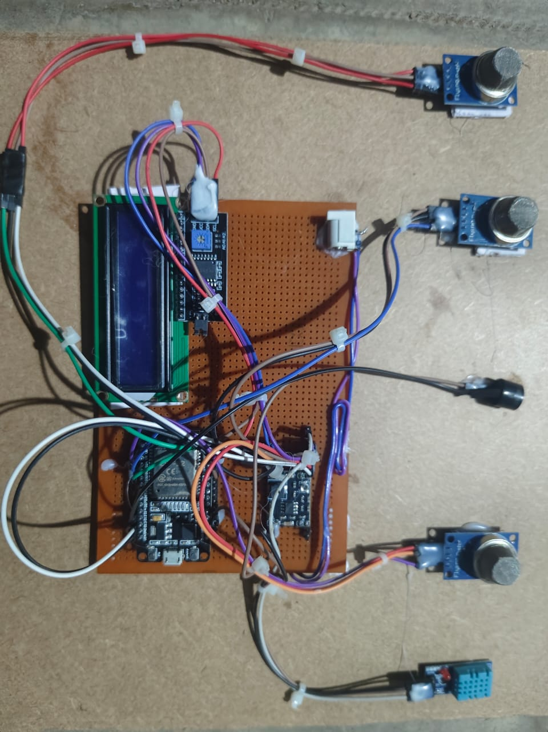
CIRCUIT

Slide 10
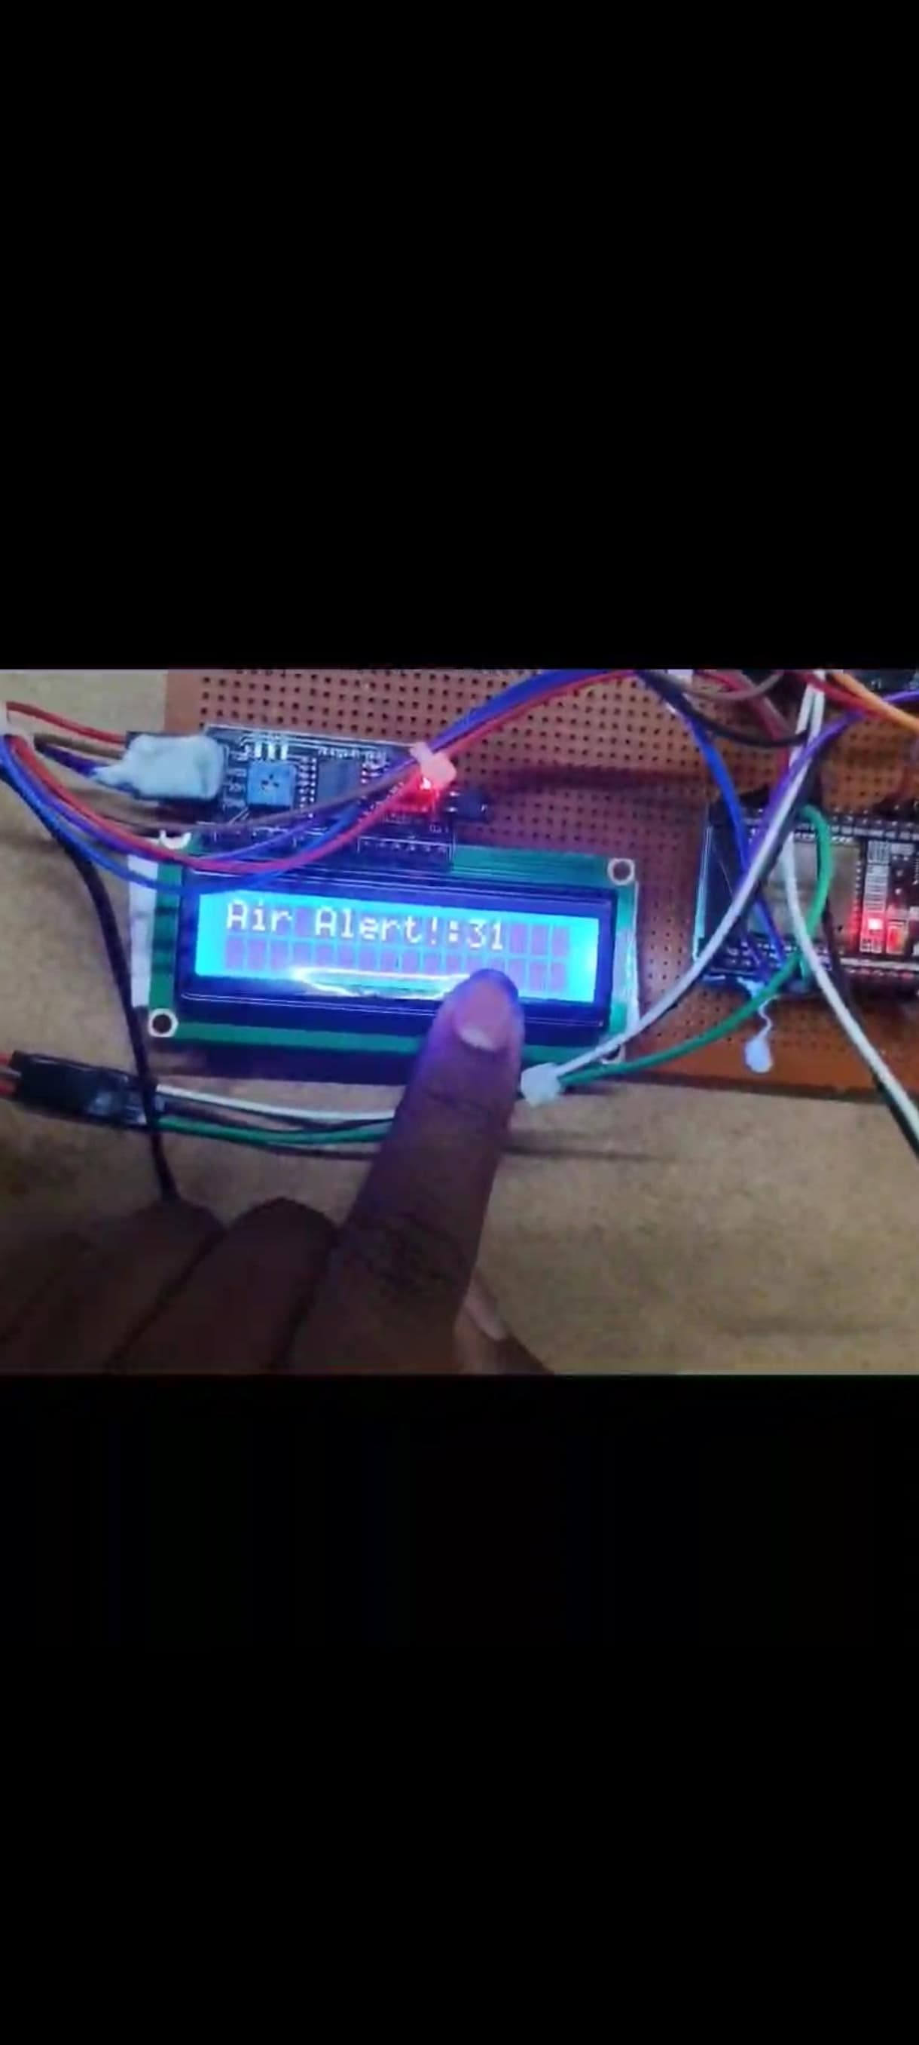
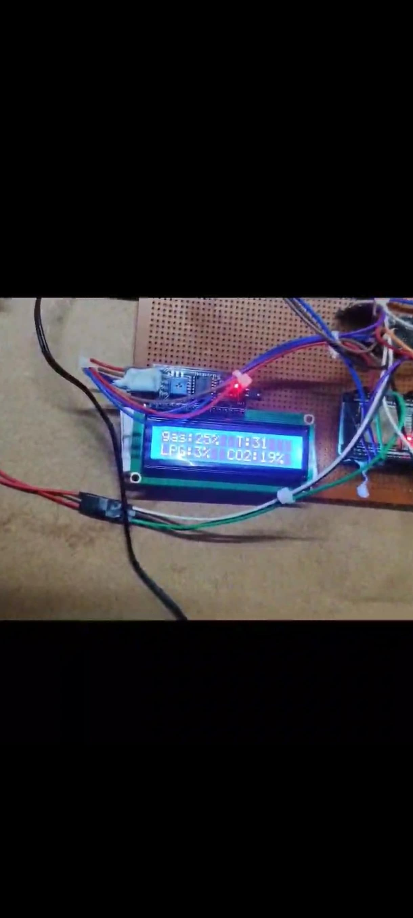
Simulation Results

Slide 11
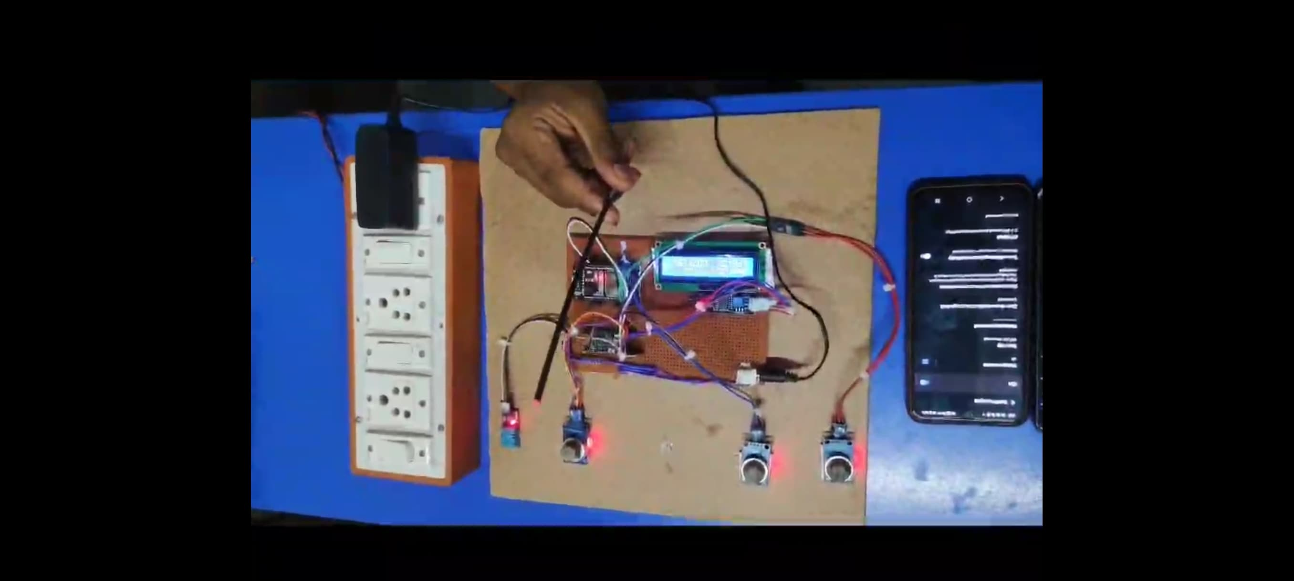
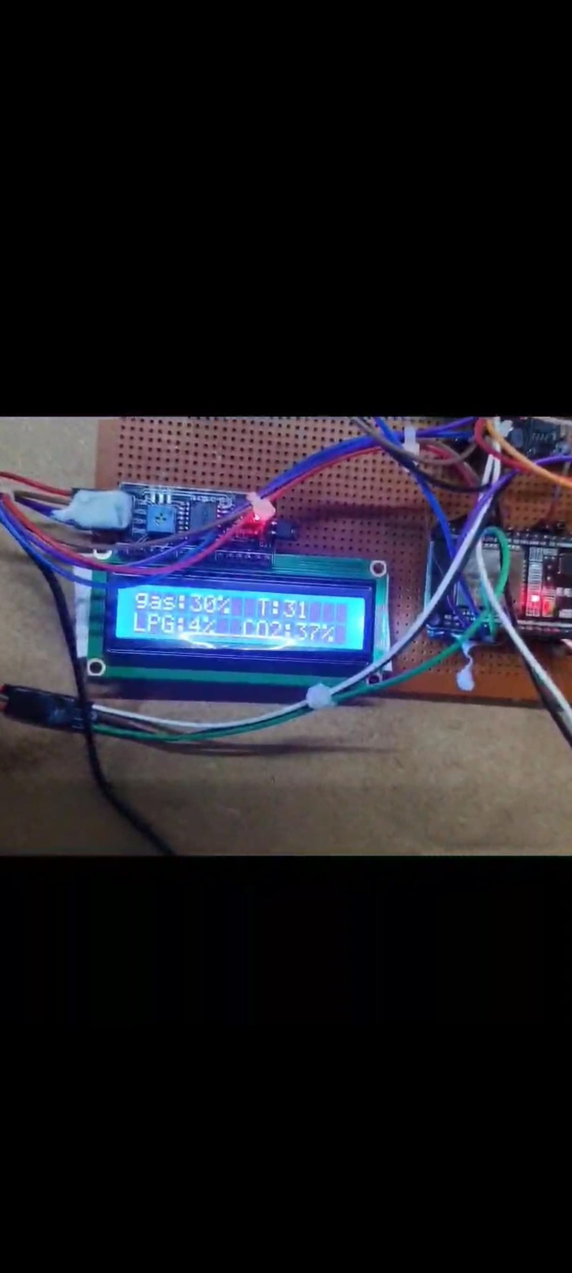
Simulation Results
The project succesfully demonstrated then output,when any gas level exceeded the present threshold (e.g., 40%), the onboard buzzer was activated and an alert flag was updated on Firebase. The LCD dynamically updated its display based on the gas readings and alert condition.

Slide 12
ADVANTAGES
Real-Time Alerts: Instantly detects harmful gas levels and triggers buzzer warnings to prevent hazards.
Cloud Access: Sends data to Firebase for remote monitoring from any location via the internet.
Cost-Effective: Uses affordable components like ESP32, MQ sensors, and DHT11, making it budget-friendly.
Portable Design: Compact setup allows easy installation in homes, vehicles, or industrial environments.
User-Friendly Interface: LCD screen displays live readings clearly, with no need for external devices.

Slide 13
APPLICATIONS
Smart Homes: Monitors indoor air quality to detect gas leaks or pollution, ensuring a safe living environment.
Industrial Safety: Used in factories or chemical plants to detect hazardous gas emissions and trigger immediate alerts to prevent accidents.
Transportation Systems: Monitors air quality inside vehicles like buses or trucks transporting flammable materials to ensure passenger and cargo safety.
Environmental Monitoring: Deployed in urban or rural areas to study pollution levels, supporting environmental research and policy-making.
Smart Cities: Integrated into IoT-based urban infrastructure to provide real-time air quality data for smart governance and public awareness.

Slide 14
CONCLUSION
The proposed air quality monitoring system using the ESP32 microcontroller successfully fulfills the objective of detecting harmful gases and monitoring environmental conditions in real time. By using sensors like MQ2, MQ6, MQ135, and DHT11, the system can measure gas concentrations, temperature, and humidity with reasonable accuracy. Data is displayed locally on an LCD screen and also uploaded to Firebase for remote access, making the system both user-friendly and IoT-enabled. Additionally, the inclusion of a buzzer ensures that critical alerts are communicated instantly. Overall, the project demonstrates a low-cost, portable, and efficient solution for improving safety and awareness in both residential and industrial environments.

Slide 15
REFERENCES
Priya, R., & Siva, M. (2020). IoT Based Smart Air Pollution Monitoring System Using Arduino. International Journal of Advanced Research in Electrical, Electronics and Instrumentation Engineering (IJAREEIE), 9(5), 3243–3248.
Hanwei Electronics Co., Ltd. (n.d.). MQ Series Gas Sensors Datasheets (MQ2, MQ6, MQ135). Retrieved from https://www.winsen-sensor.com.
Firebase. (n.d.). Firebase Realtime Database Documentation. Google Developers. Retrieved from https://firebase.google.com/docs/database.
DHT11 Datasheet. (n.d.). Aosong Electronics. Retrieved from https://components101.com/sensors/dht11-temperature-sensor.

